Slide 1
Data Structures
Lecture 15
Graph Basics
Prantik Paul [PNP]
Lecturer
Department of Computer Science and Engineering
BRAC University
Adapted From: Slides by Yosuke Mizutani

Slide 2
Graph - A superset of Trees
→ G := (V, E)
→ V := Set of vertices (nodes)
→ E := Set of edges

Slide 3
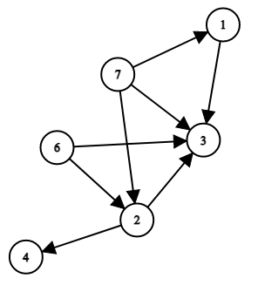
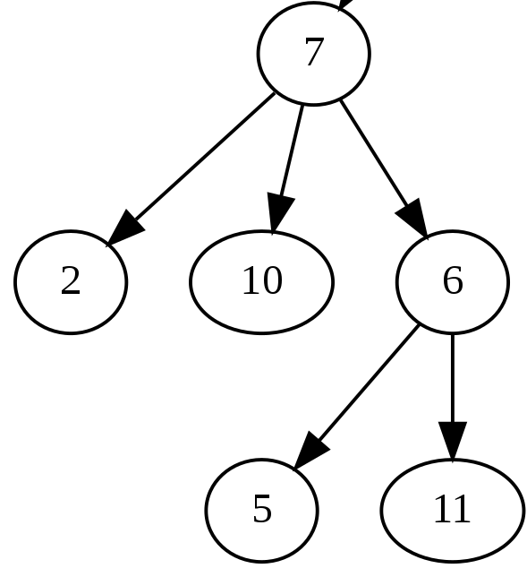
Graph - A superset of Trees

Slide 4
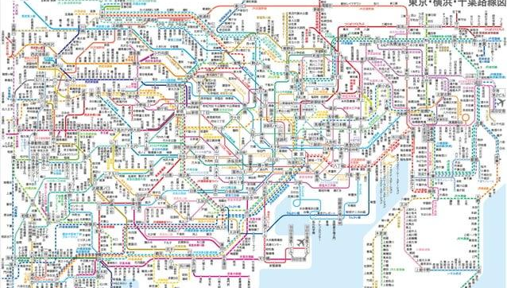
Graphs - IRL (Rail Map)

Slide 5
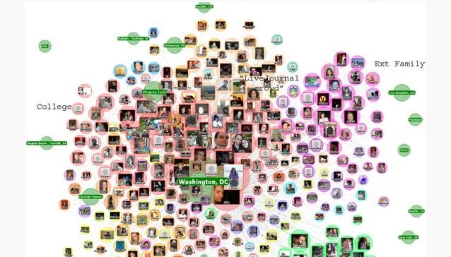
Graphs - IRL (Social Network)

Slide 6
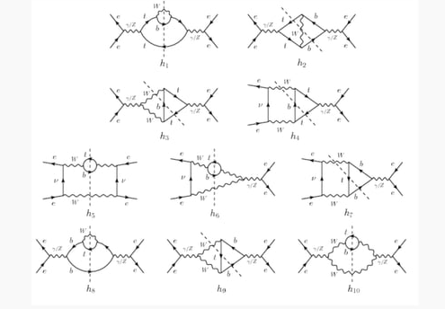
Graphs - IRL (Circuit Diagrams)

Slide 7
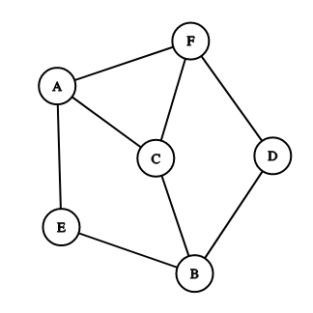
Types of Graphs
Undirected Graph
V = {A, B, C, D, E, F}
E = { {A,E}, {A,C} , {A,F}, {B,C}, {B,D}, {B,E}, {C,F}, {D,F} }

Slide 8
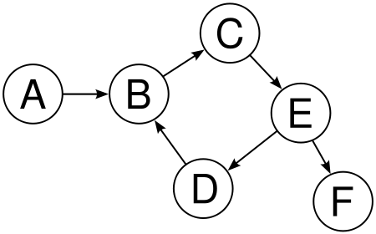
Types of Graphs
Directed Graph
V = {A, B, C, D, E, F}
E = { {A,B}, {B,C}, {C,E}, {D,B}, {E,D}, {E,F} }

Slide 9
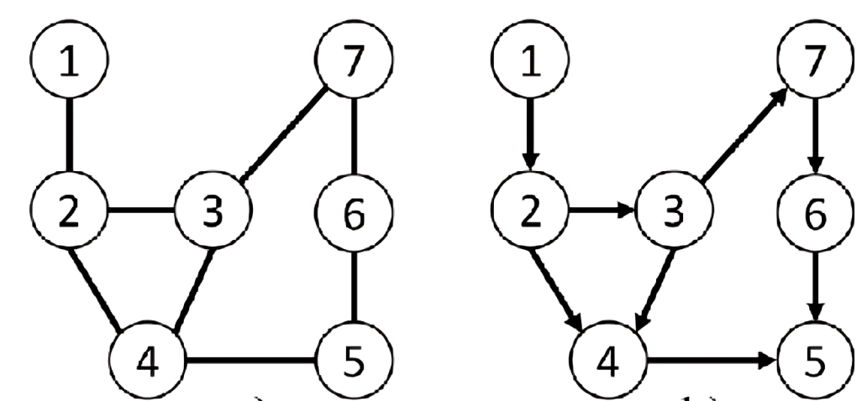
Types of Graphs
Unweighted Graph

Slide 10
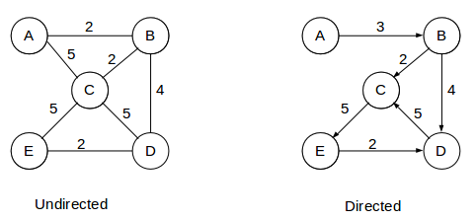
Types of Graphs
Weighted Graph

Slide 11
Graph - Basic Terminologies
Edges : Basic unit connecting vertices

Slide 12
Graph - Basic Terminologies
Adjacent Vertices: Vertices sharing an edge
Adj(A) = {E, C, F}
Adj(C) = {A, B, F}

Slide 13
Graph - Basic Terminologies
Adjacent Vertices: Vertices sharing an edge
Adj(A) = {B}
Adj(B) = {C}
Adj(E) = {D, F}

Slide 14
Graph - Basic Terminologies
Outgoing Edges: directed edges starting from a vertex

Slide 15
Graph - Basic Terminologies
Incoming Edges: directed edges reaching a vertex

Slide 16
Graph - Basic Terminologies
Degree : Total number of edges connected to a vertex
deg(A) = 3
deg(D) = 2
deg(B) = 3
deg(E) = 2
deg(C) = 3
deg(F) = 3

Slide 17
Graph - Basic Terminologies
In Degree : total number of incoming edges to a vertex
Indeg(A) = 0
Indeg(B) = 2
Indeg(C) = 1

Slide 18
Graph - Basic Terminologies
Out Degree: total number of outgoing edges from a vertex
Outdeg(A) = 1
Outdeg(E) = 2
Outdeg(F) = 0

Slide 19
Graph - Basic Terminologies
Degree: Indegree + Outdegree
deg(A) = 1
deg(E) = 3
deg(F) = 1

Slide 20
Graph - Basic Terminologies
Source Vertex : A vertex with in-degree zero

Slide 21
Graph - Basic Terminologies
Sink Vertex : A vertex with out-degree zero

Slide 22
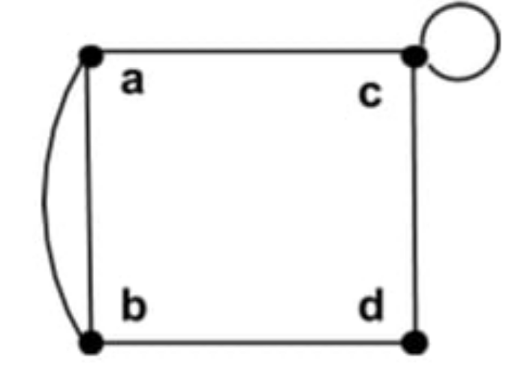
Graph - Basic Terminologies
Parallel Edges : Multiple edges between the same pair of vertices

Slide 23
Graph - Basic Terminologies
Self Loop : Edge between a vertex and itself

Slide 24
Graph - Basic Terminologies
Path : sequence of vertices where each adjacent pair is connected by an edge
Path(A, F)
A → B → C → E → F
Path(D, A)
No path

Slide 25
Graph - Basic Terminologies
Cycle : closed path where the first and last vertices are the same
B → C → E → D → B

Slide 26
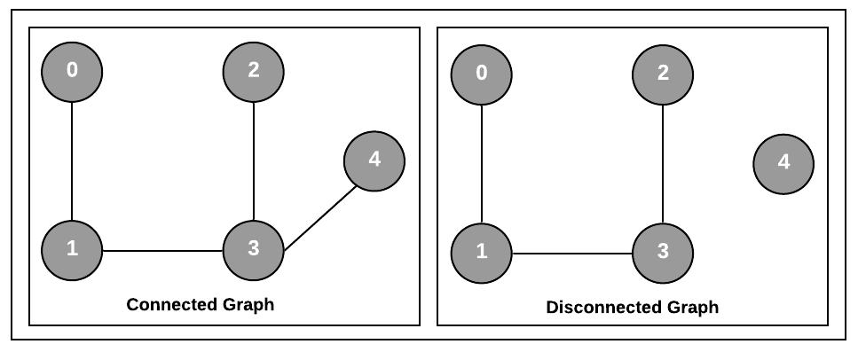
Graph - Basic Terminologies
Connected Graph: Has a path between every pair of vertices

Slide 27
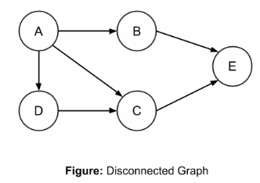
Graph - Basic Terminologies
Connected Graph: Has a path between every pair of vertices

Slide 28
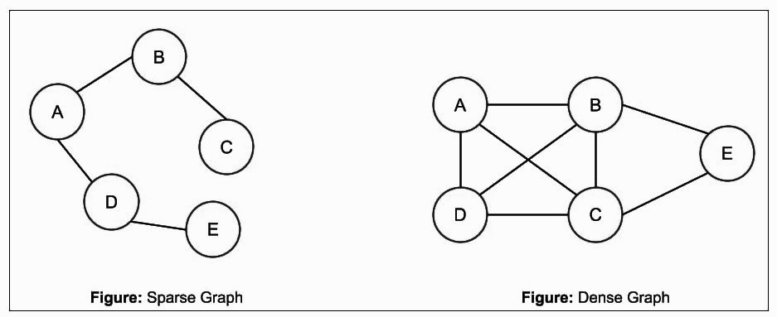
Graph - Basic Terminologies
Sparse Graph: number of edges is considerably less than the maximum number of edges

Slide 29
Graph - Basic Terminologies
Dense Graph: number of edges is close to the maximum number of edges

Slide 30
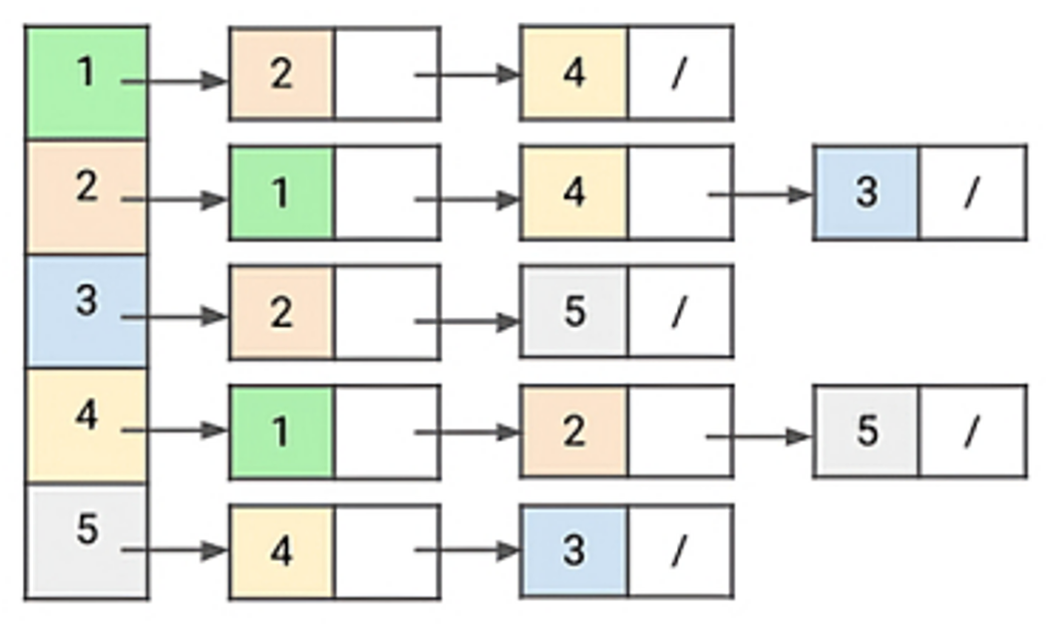
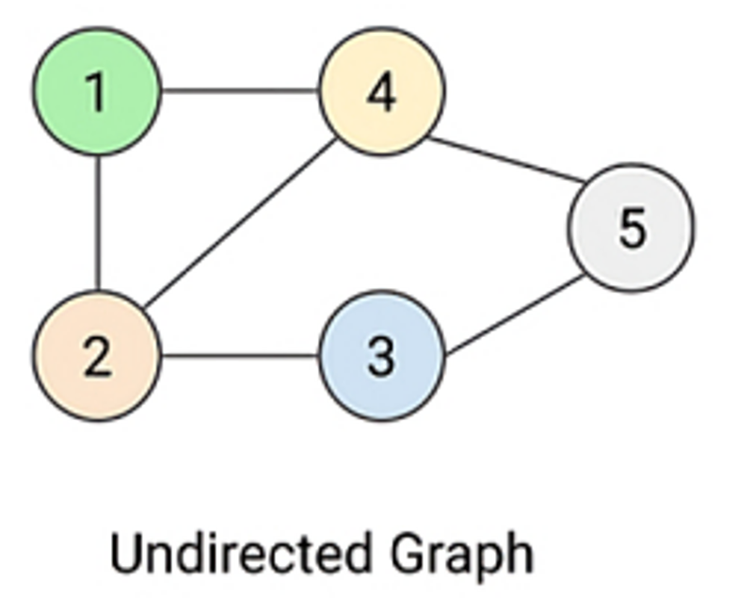
Graph - Representation - Adjacency List

Slide 31
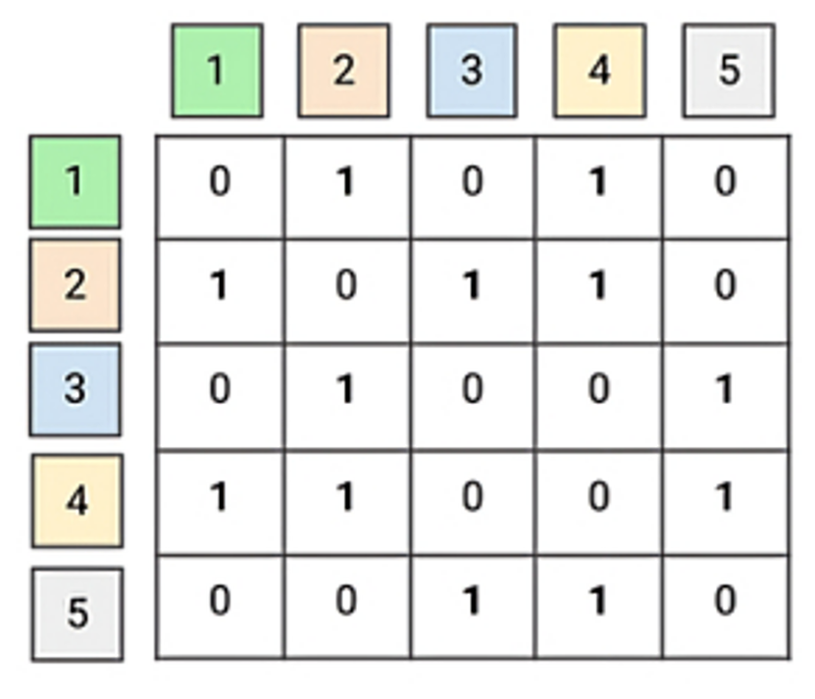
Graph - Representation - Adjacency Matrix

Slide 32
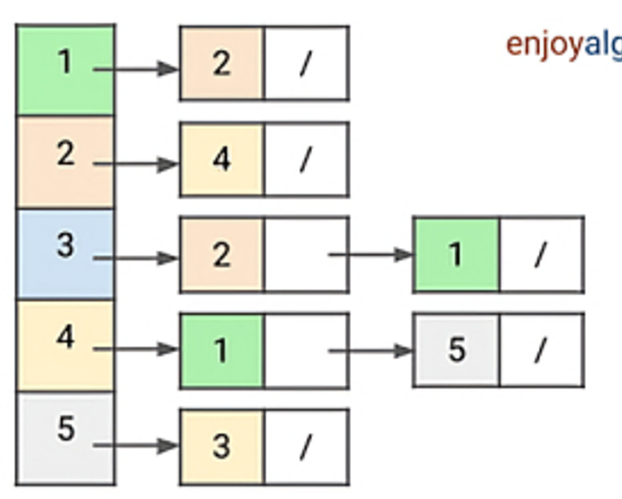
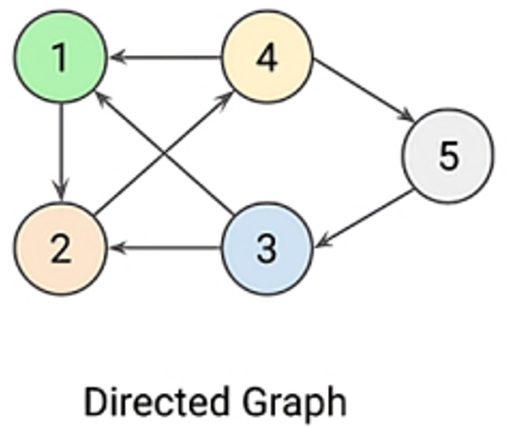
Graph - Representation - Adjacency List

Slide 33
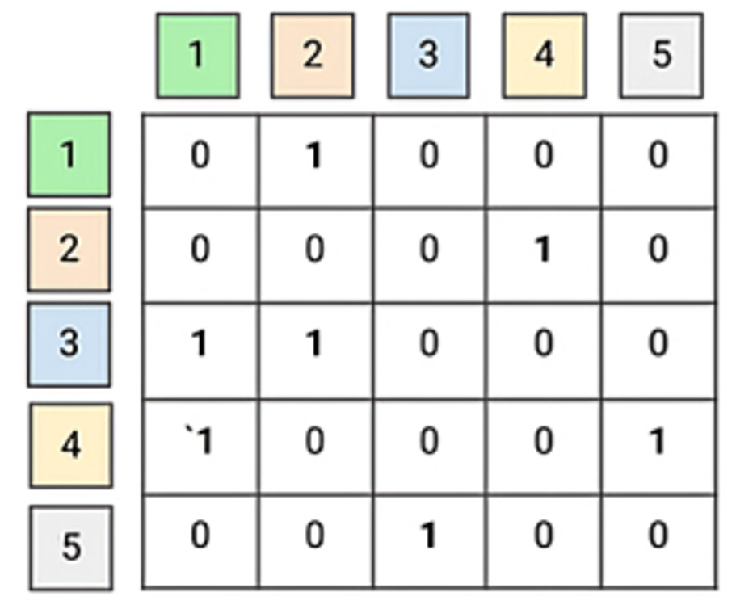
Graph - Representation - Adjacency Matrix

Slide 34
Graph - Representation
What to do for Weighted Graph’s Adjacency List Representation?
Store Tuples like <Vertice, Weight>
Instead of only Vertice

Slide 35
Graph - Representation
What to do for Weighted Graph’s Adjacency Matrix Representation?
Store Weight in the Matrix Entry
Instead of 0 or 1

